Slide 1
Sprint - 1
Over view of the work flow of the project

Slide 2
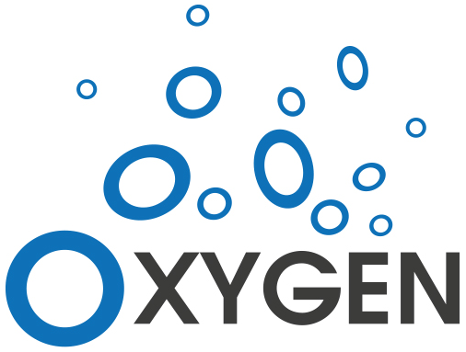
Introduction
Oxygen is a semantic based search which is used to retrieve the result meaningfully

Slide 3

Objectives
The UI
Work Flow
Tech Stack used
How and where its stores
Limitations

Slide 4
The ui
The ui is mostly composed of material ui and react js
The interface will interact with user to form heuristics query which he/she can save and there will be certain manager to handle certain modules
E.T.L Manager.
Heuristics Query Manager.
Concept Ontology Editor.
Intent Ontology Editor.
Dashboard for App
Intent
Concepts
User signup/signIn or profile
Ontology Import/Export

Slide 5
Work Flow
jobs
RESULT
Concept document graph
RETRIVES
NEO4J
searcher
CREATES
STORES
(google API)
Mongo
DB
FILTERS
google
Concept graph
Intent graph

Slide 6
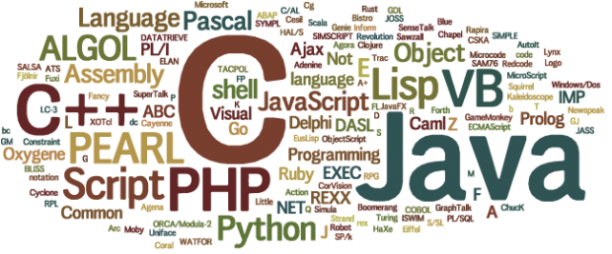
TECH STACK USED
Front End
Back End
Databases
Material UI
React js
Node js
Express js
Mongo db
Neo4j

Slide 7
How and where dATA stores
NEO4J
I HAVE
INTENT GRAPH
CONCEPT GRAPH
CONCEPT DOCUMENT GRAPH
(as JSON)
I HAVE
THE URLS
THE QUERIES
MONGO DB

Slide 8
LIMITATIONS
LIMITED SEARCH
MAY NOT BE FULLY RESPONSIVE

Slide 9
THANK YOU

